Slide 1

Maze Generator Project
By Joseph Rand

Slide 2
Overview
The purpose of this project is to solve a randomly generated maze. The reason I picked this topic is that I am generally fond of random numbers as the results are rarely the same depending on the constraints used.
This project uses the backtracking algorithm to construct the maze, and the A* pathfinding algorithm to solve the maze.
The maze is a grid of nodes and each node has properties that help the program decide how to proceed.

Slide 3
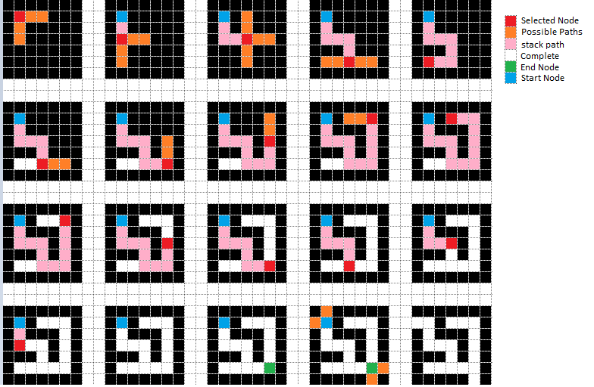
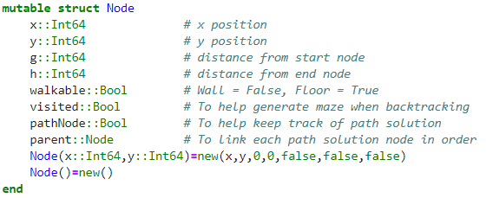
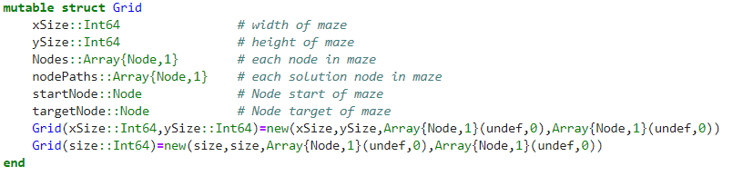
Backtracking Algorithm
A backtracking algorithm attempts to solve a given problem by testing all possible paths towards a solution until a solution is found.
Each time a path is tested, if a solution is not found, the algorithm backtracks to test another possible path and so on until the stack is empty.

Slide 4
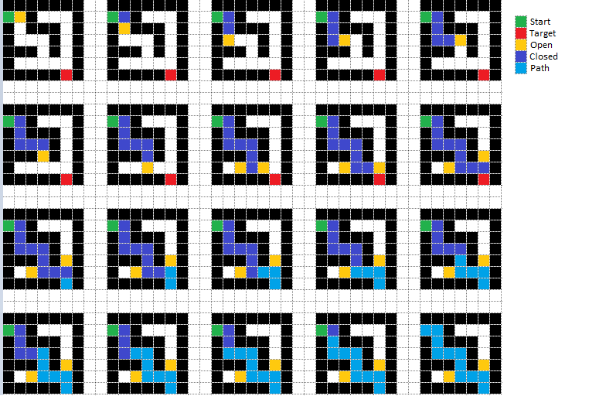
A* Algorithm
A* is an informed search algorithm, or a best-first search, meaning that it is formulated in terms of weighted graphs.
Starting from a specific starting node of a graph, it aims to find a path to the given goal node having the smallest cost (least distance travelled, shortest time, etc.). It does this by maintaining a tree of paths originating at the start node and extending those paths one edge at a time until open is empty, or a solution is found.

Slide 5
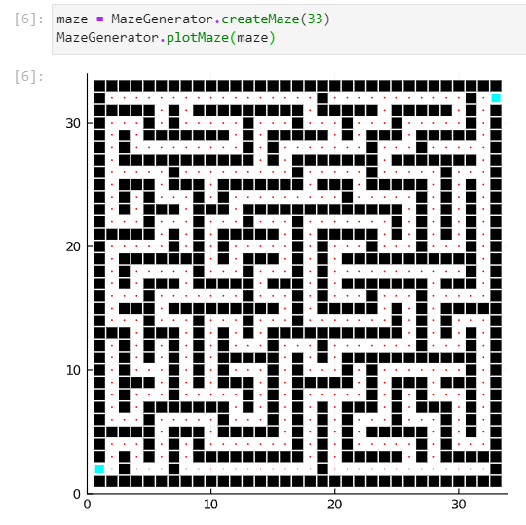
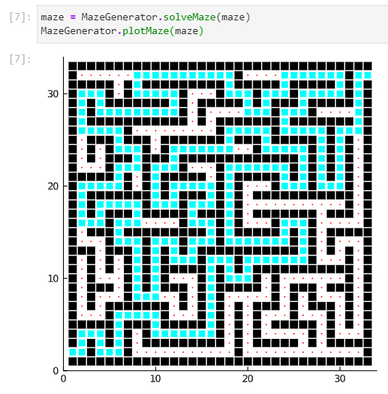
Program Results
Backtracking Output | A* Output | Animated Solution

